Slide 1
Apprenticeship
Pathways to

Slide 2

Secondary Pathway
High School CTE Student
Pre-Apprenticeship
Apprenticeship

Slide 3
Apprenticeship Facts…
Both secondary and full time post-secondary CTE programs can enter into pre-apprenticeship agreements.
OTC/Post-Secondary can either provide related technical instruction for registered apprenticeship programs, or they may establish and sponsor a group non-joint apprenticeship program to serve multiple companies.

Slide 4
OTC/Post-Secondary Pathway
Adult Student
Pre-Apprenticeship
Apprenticeship

Slide 5
Corporate Pathway
Employee
Apprenticeship

Slide 6
Why Apprenticeships?
Helps recruit and develop a highly skilled workforce
Allows workers to earn and learn at the same time
Improves productivity and the bottom-line
Reduces turnover costs and increases employee retention
Creates industry driven and flexible training solutions to meet national and local needs

Slide 7

Apprenticeships Today
U.S. Dept. of Labor recognizes 1350 occupations in these industries, and more…
  Advanced Manufacturing
  Aerospace
  Biotechnical
  Construction
  Energy
  Hospitality
  Health Care
  Information Technology
  Transportation

Slide 8
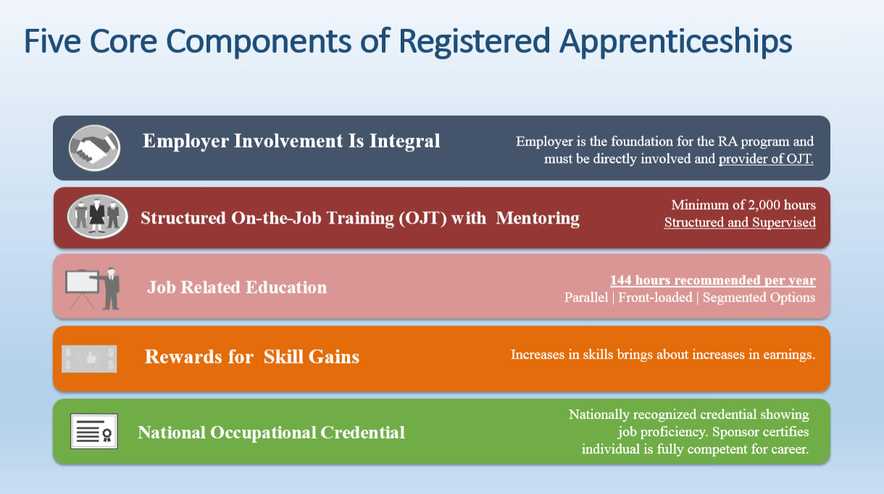

Slide 9
Parts of an Apprenticeship Program
Related Technical Instruction Curriculum
On The Job Training Work Process Schedule
Standards of Apprenticeship

Slide 10
Related Technical Instruction
At least 144 hours of instruction per every 2000 hours of OJT required.
Instruction must be provided by an institution of higher learning, such as an OTC or university. More than one agency may provide this instruction.
Safety training is required.
Coursework may earn college credit towards a degree.

Slide 11
On The Job Training
Work Process Schedule
OJT hours are determined by the U.S. Department of Labor Office of Apprenticeship
Programs range from 2,000 to 10,000 total hours, based upon the skills and competencies to be mastered.
Structured, supervised, systematic training.
Wages and benefits defined in an incremental schedule based on time or competency.
Journeyperson to apprentice ratio.
OJT based on industry standards & defined work process schedule.

Slide 12
Types of OJT Programs
Time Based
Traditional program
Currently 98% of all programs in Ohio
OJT time that details hours needed on specific knowledge, skills, and abilities required for completion
Competency Based
Outlined competencies listing specific knowledge, skills, and abilities required for completion
A term of training stated as minimum and maximum hours allowed for completion, with progression steps defined by competencies
Specific test methods to identify competency acquisition
Competency based programs may offer interim credentials
  Hybrid
  Combines elements of both Time and Competency based models

Slide 13
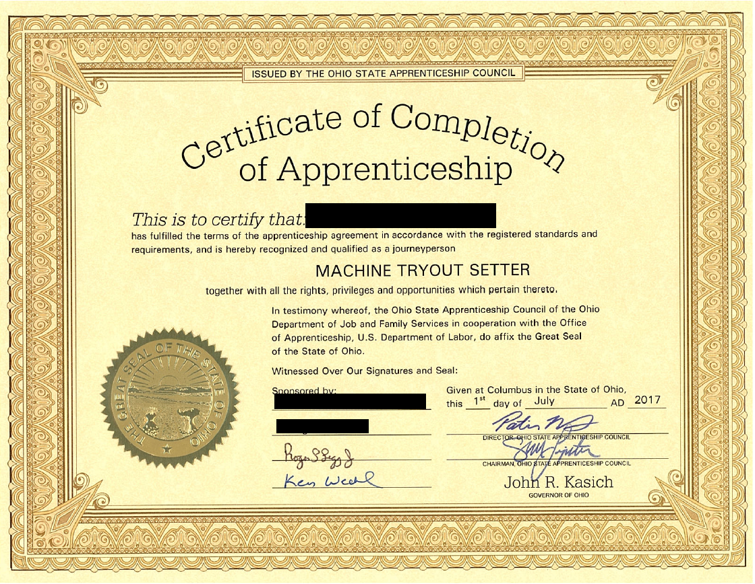
Apprenticeship Formula for Success
Related
Technical
Instruction
Certificate of Completion
Journeyman Status
OJT
Certificate is a nationally recognized portable credential, and in some cases, a college degree

Slide 14
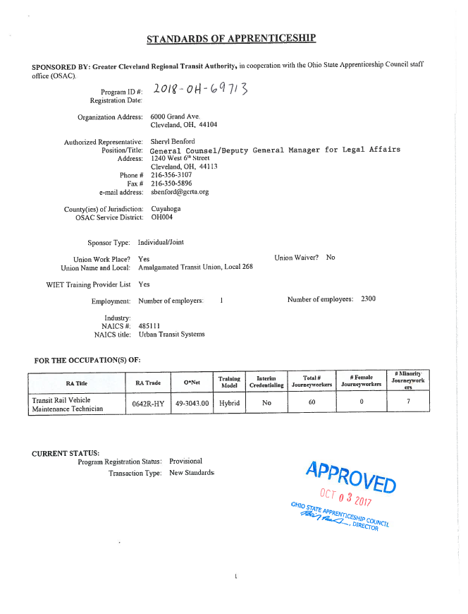
Standards Of Apprenticeship

Slide 15
What Type of Sponsorship Fits?
A “Group-Joint” program consists of a group of employers with labor organization involved.
A “Group Non-Joint” program consists of a group of employers with no labor organization involved.
An “Individual-Joint” program is an individual employer with labor organization involved.
An “Individual Non-Joint” program is an individual employer with no labor organization involved.

Slide 16

How Are Apprentices Selected?
Rank List
Random Selection
Alternative
Current employee

Slide 17
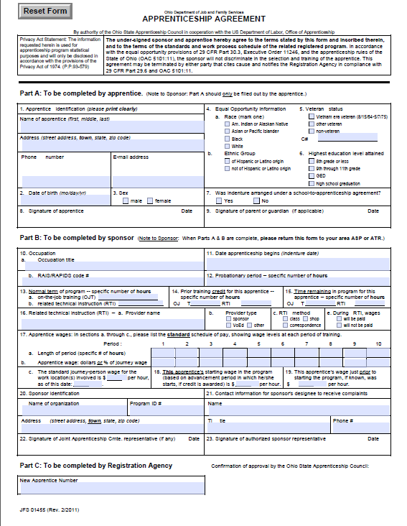
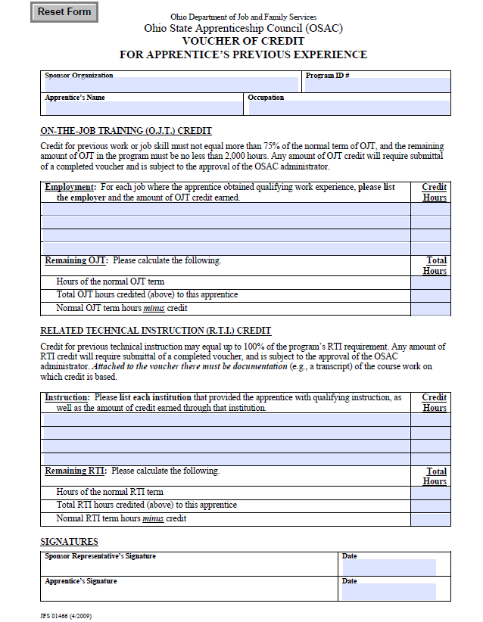
Important Documents

Slide 18
Why Pre-Apprenticeship?
Pre-Apprenticeship Allows Your CTE students a leg up on apprenticeship.
It links your CTE program to a sponsors corresponding apprenticeship program.
This has the potential to allow CTE students to earn hours towards apprenticeship RTI and OJT as outlined in the pre-apprenticeship operating plan.
Successful completion of a pre-apprenticeship program not only gives 12 graduation points, but can also result in priority to entering full apprenticeship. (Company rule dependent)

Slide 19
Your Pre-Apprenticeship
Ohio Contact
State Contact :Matthew Longfellow
Matthew.Longfellow@jfs.ohio.gov
Our Region Contact: Suzanne Gordon
Suzanne.Gordon@jfs.ohio.gov

Slide 20
Your Apprenticeship Ohio Contact
Erich Hetzel
Apprentice Ohio - Region 2
161 South High Street
Suite 300
Akron, Ohio 44308
Office: 330-252-6642
Erich.hetzel@jfs.ohio.gov

Slide 21
Thank You For Your Time!
Lynette K. Boggs
WCSCC
518 West Prospect
Smithville, OH 44677
330.669.7070 ext. 1022
lboggs@wcscc.org

